Slide 1

Air Purifiers
Clean Air for a Healthier Life
Breathe easier. Discover how air purifiers transform indoor environments and protect your health through advanced filtration technology.

Slide 2

Why Indoor Air Quality Matters
2-5x More Polluted
4 Million Deaths
Indoor air exceeds outdoor air quality
Annual indoor air pollution fatalities worldwide
80-90% Indoors
Time spent in enclosed environments
Air purifiers remove allergens, dust, smoke, VOCs, and airborne pathogens—essential for healthier homes and offices.

Slide 3
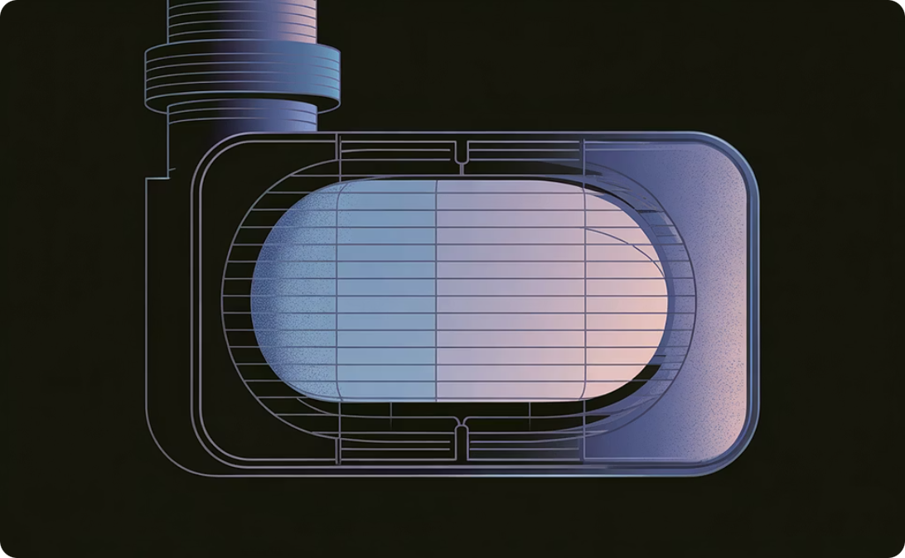
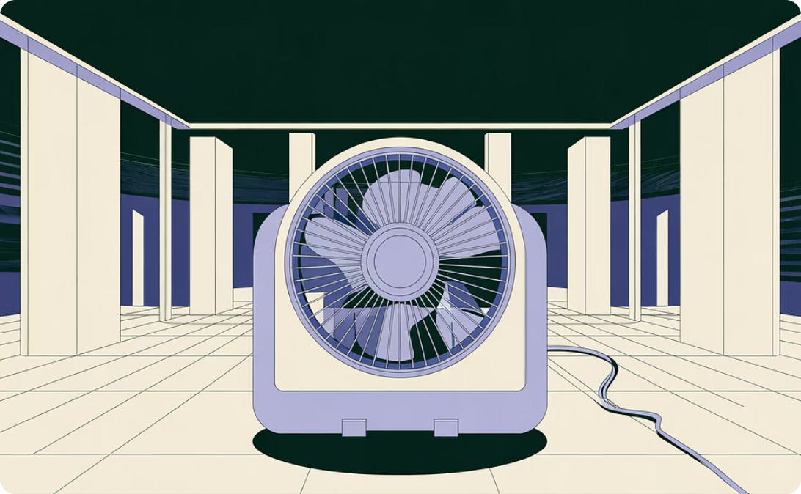
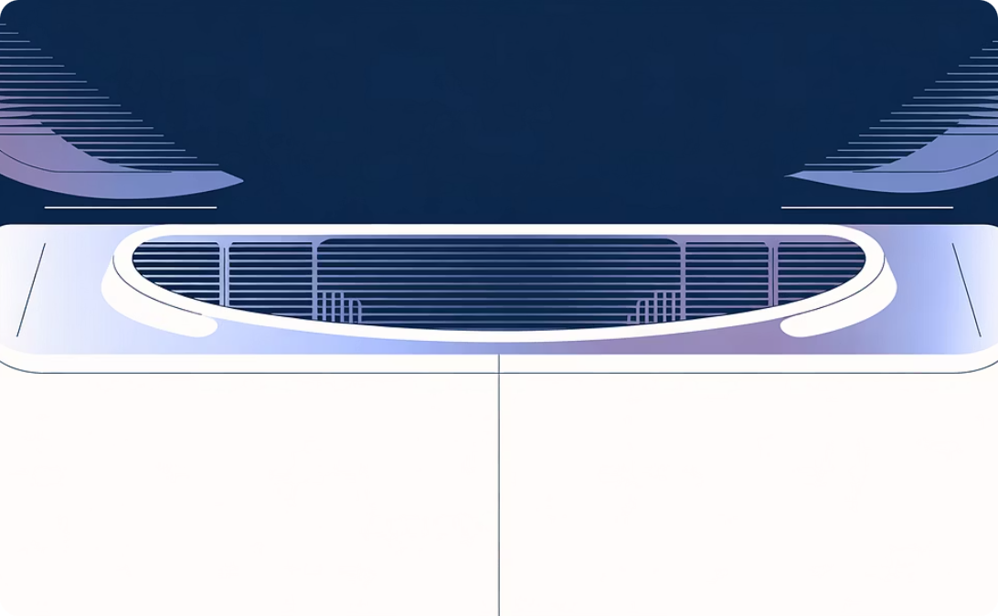
Core Components of Air Purifiers
Filter System
Fan & Motor
Housing
Traps dust, pollen, smoke, and microbes. Multi-stage filtration combines HEPA, activated carbon, and UV technology.
Draws polluted air through filters and circulates purified air back into the room continuously.
Encloses all components and optimizes airflow direction for maximum circulation efficiency.

Slide 4

How Air Purifiers Work: The Purification Process
Air Intake
Fan draws polluted air with particles and contaminants
Pre-Filter
Captures large debris: dust, hair, and visible particles
Activated Carbon
Absorbs odors and volatile organic compounds (VOCs)
HEPA Filter
Traps 99.97% of particles ≥0.3 microns: allergens, bacteria, smoke
UV-C Sterilization
Optional: kills viruses and bacteria for enhanced protection
Clean Air Release
Purified air circulates back, continuously refreshing atmosphere

Slide 5


Health Benefits & Best Practices
Key Benefits
Maximum Effectiveness
Reduces asthma and allergy triggers
Run continuously in frequently used rooms
Eliminates odors and freshens air
Keep doors and windows closed
Prevents airborne infections
Match purifier size to room square footage (CFM)
Improves sleep quality
Replace filters regularly per manufacturer guidelines
Enhances overall wellness
Choose HEPA models; avoid ionic or ozone generators
Clean air is not a luxury—it's essential for better health, comfort, and quality of life.

